Slide 1

One Minnesota Conference
Susan Brower, Minnesota State Demographer
January 2015

Slide 2
Growth in Minnesota’s
“older adult” population
Sources: U.S. Census Bureau, MN State Demographic Center
Notes:
2
2

Slide 3
Growth in Minnesota’s
“older adult” population
Sources: U.S. Census Bureau, MN State Demographic Center
Notes:
3
3

Slide 4
Avg. workers added Per YEAR
Minnesota, 16+
Source: U.S. Census Bureau, Minnesota State Demographic Center Projections

Slide 5
Real GDP growth
Working-age population growth
Labor force participation
Productivity growth

Slide 6
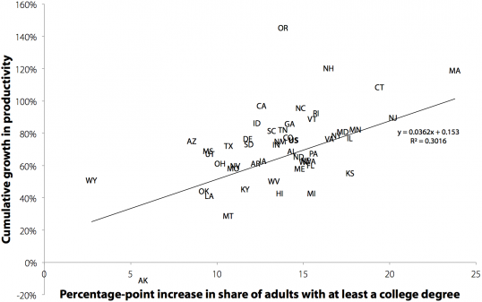
States’ Rising Ed Attainment & Growth in Productivity
Source: EPI analysis of unpublished total economy productivity data from the Bureau of Labor Statistics (BLS) Labor Productivity and Costs program, state employment data from BLS Local Area Unemployment Statistics, and college attainment data from the Current Population Survey basic monthly microdata

Slide 7
Black, Latino and Asian populations growing rapidly
Source: U.S. Census Bureau & Minnesota State Demographic Center
Notes:
7
7

Slide 8
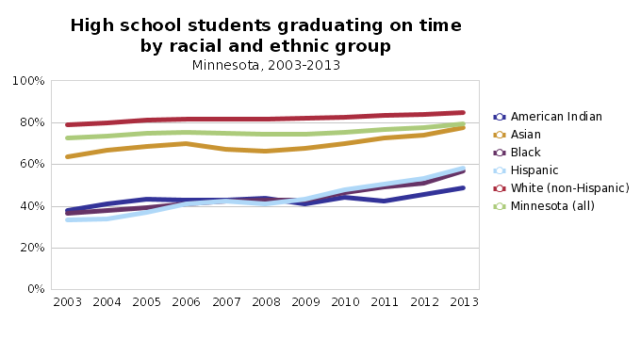
gaps in educational achievement and attainment exist across racial groups
Source: Tabulated by MN Compass from Minnesota Department of Education data

Slide 9
For the first time in MN history:
More 65+ than school-age by 2020
Source: U.S. Census Bureau & Minnesota State Demographic Center
Notes:
9
9
Three main budget drivers at the state level school age kids, college age kids, and the older population. Education and Health Care are the largest expenditures in the state budget. By 2020 there will be more older adults in MN than school-age children. This will certainly have an effect on where and how we spend our state money.

Slide 10
Demographic shifts will change demand for public services
General Fund Expenditures
2014-2015
Within Health & Human Services
Medical Assistance Expenditures: 25% of GF spending (8.5 billion)
Medical Assistance Expenditures for the Elderly and Disabled: 16% of GF spending (5.5 billion)
MA expenditures include basic care, long-term care waivers and long-term institutional care
Sources: Minnesota Management and Budget, February 2013. House Research, Long-Term Care Services for the Elderly, November 2012

Slide 11
Demographic change will shape the future…but not completely determine it
Our demographic future is sobering IF we continue to adhere to the policies and institutions that we have built for our demographic past.
Aging trend will bring new opportunities; license to innovate new pathways to well-being.

